Slide 1
Case Study – The Linux OS
Part I
Mostly taken from:
  Silberschatz – Chapter 20
  Nutt – Chapter 20

Slide 2
The Linux System
Linux History
Design Principles
Kernel Modules
Process Management
Scheduling
Memory Management
File Systems
Input and Output
Interprocess Communication
Network Structure
Security

Slide 3
History
Linux is a modern, free operating system based on UNIX standards
First developed as a small but self-contained kernel in 1991 by Linus Torvalds, with the major design goal of UNIX compatibility exclusively on PC platform
It has been designed to run efficiently and reliably on common PC hardware, but also runs on a variety of other platforms
The core Linux operating system kernel is entirely original, but it can run much existing free UNIX software, resulting in an entire UNIX-compatible operating system free from proprietary code

Slide 4
The Linux System
Linux uses many tools developed as part of Berkeley’s BSD operating system, MIT’s X Window System, and the Free Software Foundation's GNU project
Linux networking-administration tools were derived from 4.3BSD code; later BSD derivatives such as Free BSD have borrowed code from Linux in return
The Linux system is maintained by a loose network of developers collaborating over the Internet, with a small number of public ftp sites acting as de facto standard repositories

Slide 5
Linux Licensing
The Linux kernel is distributed under the GNU General Public License (GPL), the terms of which are set out by the Free Software Foundation
Anyone using Linux, or creating their own derivative of Linux, may not make the derived product proprietary; software released under the GPL may not be redistributed as a binary-only product

Slide 6
The Linux Kernel
Version 0.01 (May 1991) had no networking, ran only on 80386-compatible Intel processors and on PC hardware, had extremely limited device-driver support, and supported only the MINIX file system
Linux 1.0 (March 1994) included:
  Support for UNIX’s standard TCP/IP networking protocols
  BSD-compatible socket interface for networking programming
  Device-driver support for running IP over an Ethernet
  Enhanced file system
  Support for a range of SCSI controllers for high-performance disk access
  Extra hardware support
Version 1.2 (March 1995) was the final PC-only Linux kernel

Slide 7
Linux 2.0
Released in June 1996, 2.0 added two major new capabilities:
  Support for multiple architectures, including a fully 64-bit native Alpha port
    Available for Motorola 68000-series processors, Sun Sparc systems, and for PC and PowerMac systems
  Support for multiprocessor architectures
Other new features included:
  Improved memory-management code
  Improved TCP/IP performance
  Support for internal kernel threads, for handling dependencies between loadable modules, and for automatic loading of modules on demand
  Standardized configuration interface
2.4 and 2.6 increased Symmetric Multiprocessing (SMP) support, added journaling file system, preemptive kernel, 64-bit memory support

Slide 8
Design Principles
Linux is a multiuser, multitasking system with a full set of UNIX-compatible tools
Its file system adheres to traditional UNIX semantics, and it fully implements the standard UNIX networking model
Main design goals are speed, efficiency, and standardization
Linux is designed to be compliant with the relevant POSIX documents; at least two Linux distributions have achieved official POSIX certification
The Linux programming interface adheres to the SVR4 UNIX semantics, rather than to BSD behavior

Slide 9
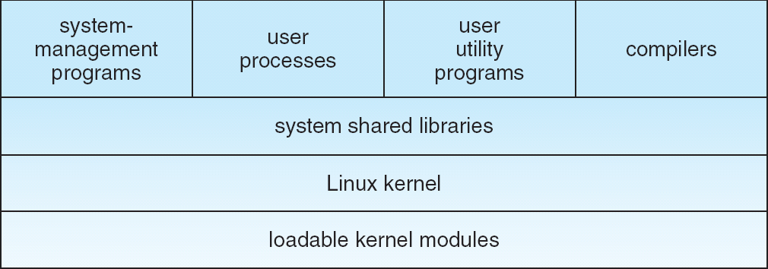
Components of a Linux System
Like most UNIX implementations, Linux is composed of three main bodies of code
  Kernel
  System libraries
  System utilities
The most important distinction between the kernel and the other components

Slide 10
Components of a Linux System
The kernel is responsible for maintaining the important abstractions of the operating system
  Kernel code executes in kernel mode with full access to all the physical resources of the computer
  All kernel code and data structures are kept in the same single address space

Slide 11
Components of a Linux System
The system libraries define a standard set of functions through which applications interact with the kernel, and which implement much of the operating-system functionality that does not need the full privileges of kernel code – for example sorting
The system utilities perform individual specialized management tasks – for example configure network devices, daemons, etc.

Slide 12
The Linux Kernel
Designed and implemented as a monolithic kernel
Process and resource management, memory management, and file management are implemented within a single executable software module.
Data structures for each aspect are available to all – single address space for the entire kernel code including device drivers.
Main concern: performance
  Single address apace
    no context switching when a process calls an operating system function or when a hardware interrupt is delivered.

Slide 13
OS Kernel Organization
Operating System Kernel
File
Manager
Process & Resource
Manager
Memory
Manager
Device
Manager
Processor(s)
Main Memory
Devices
Hardware

Slide 14
The Linux Kernel – device manager
Implemented as a separate collection of device drivers and interrupt handlers.
The only new kernel space software that should be added to the system should be for device management.
Was designed to support disk drives, keyboards, and character displays.
With the evolution of technology it became difficult to provide kernel support
Linux Kernel
Device independent
interface
Device
Drivers
Devices

Slide 15
The Linux Kernel – module manager
The new support is provided through modules
The module interface is more general than the Device Driver interface.
Linux module is an independent software unit that can be designed and implemented later.
Can be compiled, loaded, and unloaded independent of the rest of the kernel
A kernel module may typically implement a device driver, a file system, or a networking protocol
Linux Kernel
DD
interface
Module
Interface
Device
Drivers
Modules

Slide 16
Kernel Modules
Loadable modules run in privileged kernel mode
The module interface allows third parties to write and distribute, on their own terms, device drivers or file systems that could not be distributed under the GPL
Three components to Linux module support:
  module management
  driver registration
  conflict resolution

Slide 17
Module Management
Supports loading modules into memory and letting them talk to the rest of the kernel
Module loading is split into two separate sections:
  Managing sections of module code in kernel memory
  Handling symbols that modules are allowed to reference
    Linux maintains an internal symbol table in the kernel
    A symbol must be exported explicitly by the kernel
The module requestor manages loading requested, but currently unloaded, modules; it also regularly queries the kernel to see whether a dynamically loaded module is still in use, and will unload it when it is no longer actively needed

Slide 18
Module loading
Reservation of continuous area in kernel memory
Updating of kernel symbol table

Slide 19
Driver Registration
Allows modules to tell the rest of the kernel that a new driver has become available
The kernel maintains dynamic tables of all known drivers, and provides a set of routines to allow drivers to be added to or removed from these tables at any time
Each module must implement init_module() and cleanup_module() functions.
A new API for the module may also be defined.
Each new function that is added to the module must be registered/ unregistered with the kernel when the module is installed/ uninstalled.
Registration tables include:
  Device drivers
  File systems
  Network protocols
  Binary format

Slide 20
Conflict Resolution
A mechanism that allows different device drivers to reserve hardware resources and to protect those resources from accidental use by another driver
Prevent modules from clashing over access to hardware resources

Slide 21
Linux Kernel – Process and Resource Management
Timers,
Interrupts,
…
Protection
Mechanism
IPC
Scheduler
Kernel
Data
Structures
Process Manager
Process management provides facilities to create, destroy, synchronize, and protect other processes.
Resource management involves creating appropriate abstractions to represent entities that a process might request and block their execution if the resources are unavailable.

Slide 22
Process Management
UNIX process management separates the creation of processes and the running of a new program into two distinct operations.
  The fork system call creates a new process
  A new program is run after a call to execve
Under UNIX, a process encompasses all the information that the operating system must maintain to track the context of a single execution of a single program
Under Linux, process properties fall into three groups:
  the process’s identity,
  Environment
  context

Slide 23
Process Identity
Process ID (PID).
  The unique identifier for the process
  used to specify processes to the operating system when an application makes a system call to signal, modify, or wait for another process
Credentials.
  Each process must have an associated user ID and one or more group IDs that determine the process’s rights to access system resources and files
PID of a process cannot be changed

Slide 24
Process Environment
The process’s environment is inherited from its parent, and is composed of two null-terminated vectors:
  The argument vector lists the command-line arguments used to invoke the running program
  The environment vector is a list of “NAME=VALUE” pairs that associates named environment variables with arbitrary textual values
Passing environment variables among processes and inheriting variables by a process’s children are flexible means of passing information to components of the user-mode system software
The environment-variable mechanism provides a customization of the operating system that can be set on a per-process basis, rather than being configured for the system as a whole

Slide 25
Process Context
The (constantly changing) state of a running program at any point in time
  Scheduling context
  File table
  File system
  Signal handler
  Virtual memory
  Accounting

Slide 26
Process Context
The scheduling context is the most important part of the process context; it is the information that the scheduler needs to suspend and restart the process
  Saved copies of all the process registers
    FP registers are saved separately
  Scheduling priority
  Outstanding signals waiting to be delivered to the process
  Process’ kernel stack
    a separate area of kernel memory reserved for use exclusively by kernel-mode code.
    Used by system calls and interrupts

Slide 27
Process Context (Cont.)
The file table lists the existing open files and is an array of pointers to kernel file structures
  When making file I/O system calls, processes refer to files by their index into this table
The file-system context applies to requests to open new files
  The current root and default directories to be used for new file searches are stored here
The signal-handler table defines the routine in the process’s address space to be called when specific signals arrive
The virtual-memory context of a process describes the full contents of the its private address space
The kernel maintains accounting information about the resources currently being consumed by each process, and the total resources consumed by the process in its lifetime so far

Slide 28
Processes and Threads
Processes represent the execution of single programs
Threads represent separate, concurrent execution context within a single process running a single program.
Any two separate processes have their own independent address space even if they are using shared memory.
Two threads within the same process will share the same address space.
Any change to the virtual memory layout made by one thread will be immediately visible to other threads in the same process.

Slide 29
Processes and Threads
Linux does not hold process’ entire context within the main process data structure.
  Context is held within independent sub-contexts
    File-system context, file-descriptor data structure, signal-handler table, and virtual memory contexts
Linux uses the same internal representation for processes and threads; a thread is simply a new process that happens to share the same address space as its parent
A distinction is only made when a new thread is created by the clone system call
  fork creates a new process with its own entirely new process context
  clone creates a new process with its own identity, but that is allowed to share the data structures of its parent
  Deep versus shallow copy
Using clone gives an application fine-grained control over exactly what is shared between two threads
In fact, fork is a special case of clone.

Slide 30
Kernel Synchronization
A request for kernel-mode execution can occur in two ways:
  A running program may request an operating system service, either explicitly via a system call, or implicitly, for example, when a page fault occurs
  A device driver may deliver a hardware interrupt that causes the CPU to start executing a kernel-defined handler for that interrupt
Kernel code has to run in the critical section as all data structures are shared.
Kernel synchronization requires a framework that will allow the kernel’s critical sections to run without interruption by another critical section

Slide 31
Kernel Synchronization (Cont.)
Linux uses two techniques to protect critical sections:
  Normal kernel code is non-preemptible
  – when a time interrupt is received while a process is
  executing a kernel system service routine, the kernel’s
  need_resched flag is set so that the scheduler will run
  once the system call has completed and control is
  about to be returned to user mode
  2. The second technique applies to critical sections that occur in an interrupt service routines
  – By using the processor’s interrupt control hardware to disable interrupts during a critical section, the kernel guarantees that it can proceed without the risk of concurrent access of shared data structures

Slide 32
Kernel Synchronization (Cont.)
To avoid performance penalties, Linux’s kernel uses a synchronization architecture that allows long critical sections to run without having interrupts disabled for the critical section’s entire duration
Interrupt service routines are separated into a top half and a bottom half.
  The top half is a normal interrupt service routine, and runs with recursive interrupts disabled
  The bottom half is run, with all interrupts enabled, by a miniature scheduler that ensures that bottom halves never interrupt themselves
  This architecture is completed by a mechanism for disabling selected bottom halves while executing normal, foreground kernel code

Slide 33
Task Control Flow
Task is running
IRQ
Trap
Top Half
Execute ISR
System Call
Sched. Bottom-half
Exec system func
Ret from sys call
Task continues
Schedule new task

Slide 34
Task Control Flow
System Call
The process traps into the kernel code to the entry point of the target function
The function is executed
Function returns to the kernel
The kernel performs a standard set of task in ret_from_sys_call code.
  Dispatches any accumulated system work such as handling signals
  Complete the pending bottom halves
Schedule next task
Task is running
IRQ
Trap
Top Half
Execute ISR
System Call
Sched. Bottom-half
Exec system func
ret_from_sys_call
Task continues
Schedule new task

Slide 35
Task Control Flow
Interrupt IRQ
Fast and slow interrupts
Fast interrupt
  Takes very little time
  Other interrupts are disabled
Slow interrupt
  Top half and bottom half
  other interrupts are disabled
  Top half is executed
  Interrupts are enabled
  Bottom half is queued for the kernel to schedule
Task is running
IRQ
Trap
Top Half
Execute ISR
System Call
Sched. Bottom-half
Exec system func
Ret from sys call
Task continues
Schedule new task

Slide 36
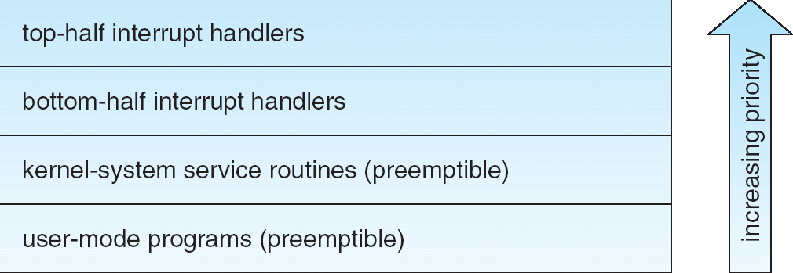
Interrupt Protection Levels
Each level may be interrupted by code running at a higher level, but will never be interrupted by code running at the same or a lower level
User processes can always be preempted by another process when a time-sharing scheduling interrupt occurs

Slide 37
The Linux Scheduler
Responsible for multiplexing the CPU among the programs in memory.
Incorporates the scheduling policy including the priority based policy.
Always runs as a task that is associated either with a user process or an interrupt.
Scheduling policy for each can be set at runtime – sched_setscheduler()

Slide 38
Process Scheduling
Linux uses three process-scheduling algorithms:
  A time-sharing algorithm for fair preemptive scheduling between multiple processes - SCEHD_OTHER
  Two real-time algorithms for tasks where absolute priorities are more important than fairness
    FCFS or FIFO - SCHED_FIFO
    Round-robin - SCHED_PR
A process’s scheduling class defines which algorithm to apply
Whenever a process with a priority that is higher than the currently running process becomes runnable, the lower priority process is preempted and the higher-priority process begins to run.

Slide 39

Process Scheduling
For time-sharing processes, Linux uses a prioritized, credit based algorithm
  The crediting rule factors in both the process’s history and its priority
  This crediting system automatically prioritizes interactive or I/O-bound processes

Slide 40
Real-time Process Scheduling
Linux has a soft real time scheduling.
Linux implements the FIFO and round-robin real-time scheduling classes; in both cases, each process has a priority in addition to its scheduling class
  The scheduler runs the process with the highest priority; for equal-priority processes, it runs the process waiting the longest
  FIFO processes continue to run until they either exit or block – not preempted by the timer interrupt
    must have supervisor permission
    If preempted by another higher priority task then it is put back at the head of the queue.
  A round-robin process will be preempted after a while and moved to the end of the scheduling queue, so that round-robing processes of equal priority automatically time-share between themselves
    If preempted by another higher priority task then it is put back at the tail of the queue.

Slide 41
Symmetric Multiprocessing
Linux 2.0 was the first Linux kernel to support SMP hardware (Symmetric Multiprocessor ); separate processes or threads can execute in parallel on separate processors
To preserve the kernel’s nonpreemptible synchronization requirements, SMP imposes the restriction, via a single kernel spinlock, that only one processor at a time may execute kernel-mode code

Slide 42
Linux Memory Manager
Demand paged virtual memory model
Page fault handler implements
  Normal page fault
  Copy-on-write strategy for sharing pages among address spaces.
Dynamic page allocation strategy – allocation based upon working set size

Slide 43
Memory Management
Linux’s physical memory-management system deals with allocating and freeing pages, groups of pages, and small blocks of memory
It has additional mechanisms for handling virtual memory, memory mapped into the address space of running processes

Slide 44
Kernel Memory Allocation – Goals
Must be fast (this is crucial)
Should minimize memory waste
Try to avoid memory fragmentation
Cooperate with other kernel subsystems

Slide 45
Managing Physical Memory
The page allocator allocates and frees all physical pages; it can allocate ranges of physically-contiguous pages on request
  Smallest block – 4KB
  Largest block – 128KB
The allocator uses a buddy-heap algorithm to keep track of available physical pages
  Each allocatable memory region is paired with an adjacent partner
  Whenever two allocated partner regions are both freed up they are combined to form a larger region
  If a small memory request cannot be satisfied by allocating an existing small free region, then a larger free region will be subdivided into two partners to satisfy the request

Slide 46
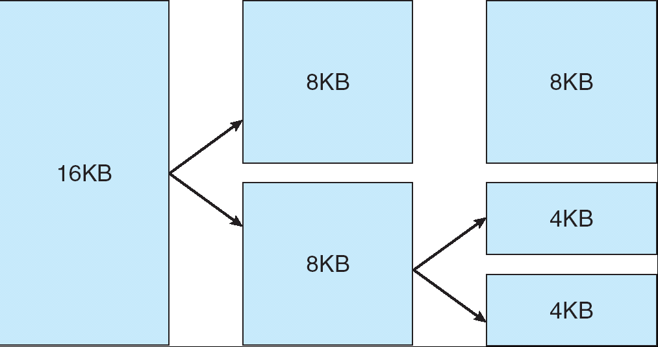
Splitting of Memory in a Buddy Heap

Slide 47
Managing Physical Memory
Memory allocations in the Linux kernel occur either statically (drivers reserve a contiguous area of memory during system boot time) or dynamically (via the page allocator)
Also uses slab allocator for kernel memory

Slide 48
Slab allocator
Kernel functions tend to request objects of the same type repeatedly, such as process descriptors, file descriptors, etc.
Many requests are for less than a full page
Wasteful to allocate an entire page!
The objective is that a single page can now be used to contain a number of objects thus saving memory and avoid internal fragmentation.
Linux uses a ‘slab allocator’ subsystem
  The memory block contains several equal-sized ‘slabs’
The slab allocator does not discard objects, but caches them

Slide 49
Slab Allocator
Divide blocks in to “large” and “small” by picking an arbitrary threshold size.
Bookkeeping for small blocks is relatively easy: just use a bitmap for each range of blocks of the same size
Allocating is easy and fast: compute the size of the block to allocate and find a free bit in the corresponding bitmap.
Freeing is also easy and fast: figure out which slab the address belongs to and clear the corresponding bit.

Slide 50
Slab Allocator
16 byte blocks:
32 byte blocks:
64 byte blocks:
16 byte block bitmap: 11011000
32 byte block bitmap: 0111
64 byte block bitmap: 00

